Slide 1
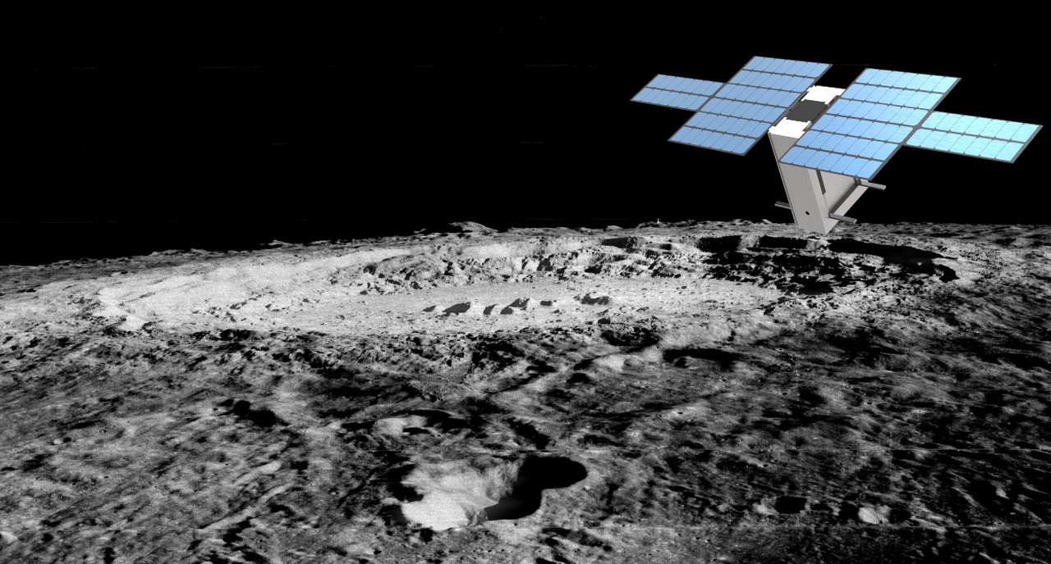
LunaH-Map Structure and Thermal Design
Robert Amzler

Slide 2
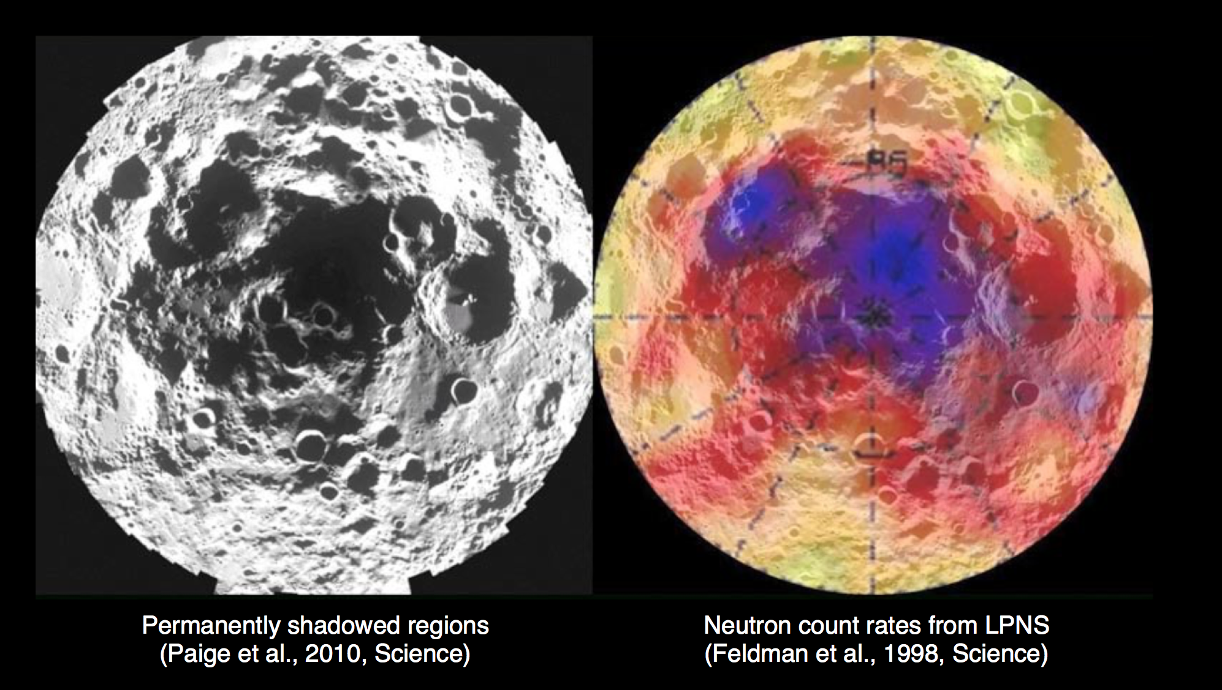
Mission Overview
6U+ CubeSat.
Constrain hydrogen abundance in the lunar south pole.
Launching in 2018 on SLS EM-1.

Slide 3
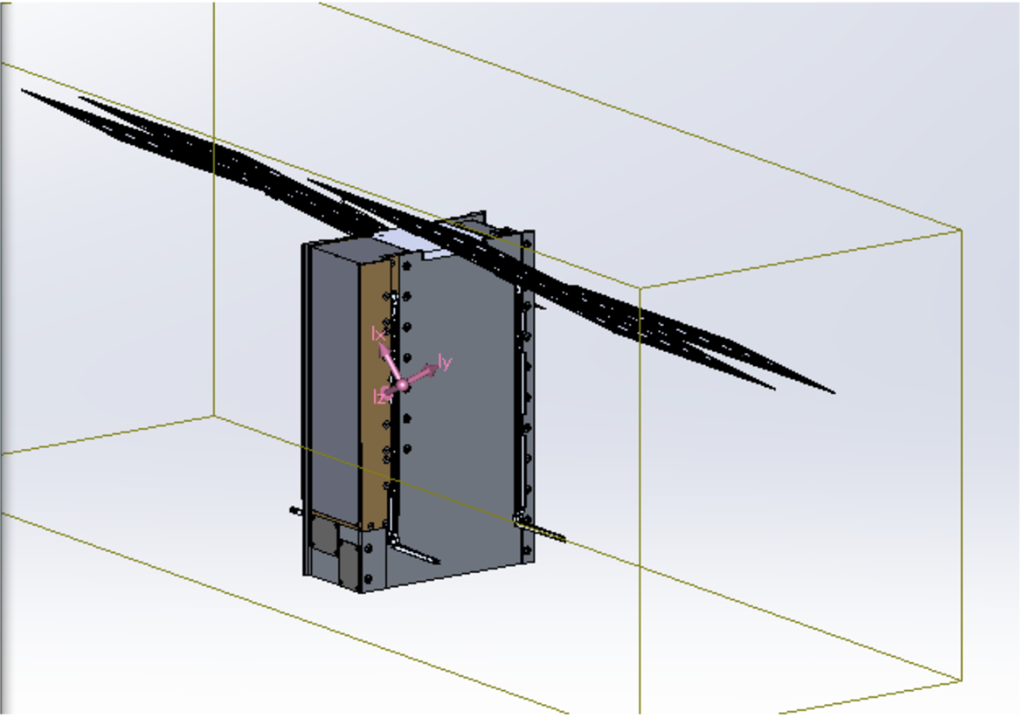
Spacecraft Overview
Major Subsystems
Science Payload:
  MiniNS neutron detector
Propulsion System:
  BIT-3 Ion Propulsion
Comms System:
  JPL’s IRIS X-Band radio
GNC:
  XB1-50

Slide 4
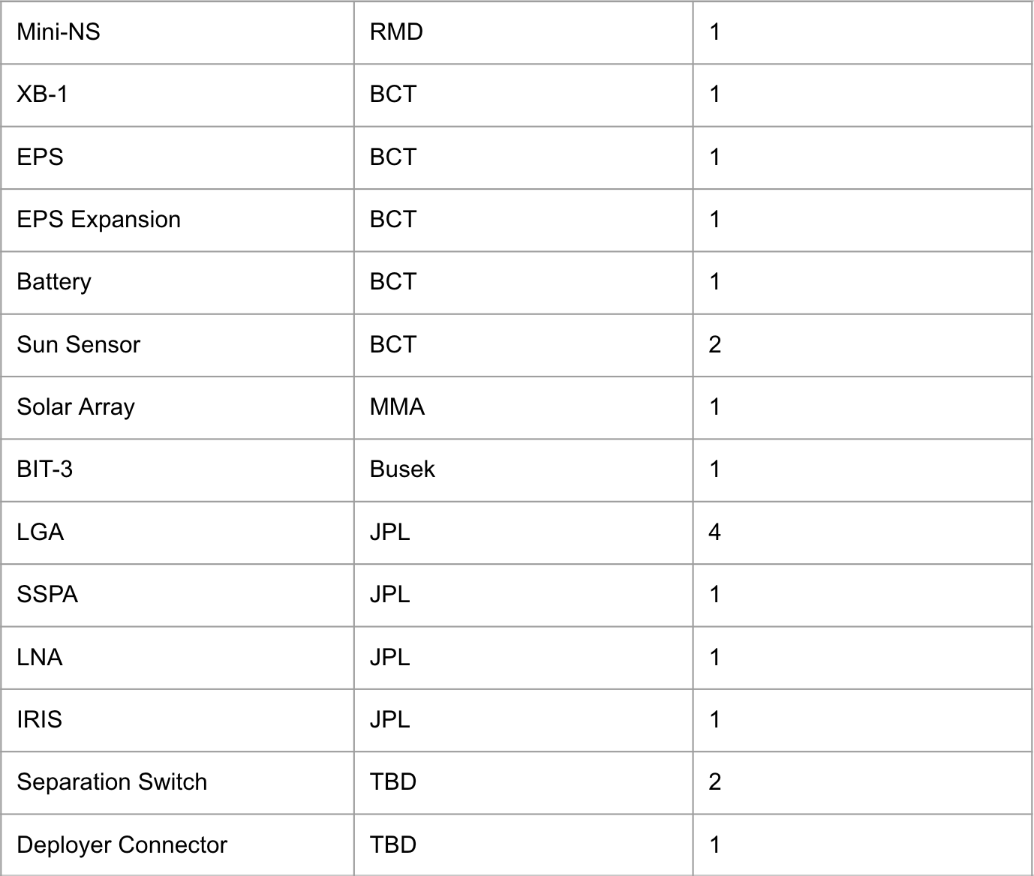
Spacecraft Overview Pt. 2
Notes:
Many components, not that much space.

Slide 5
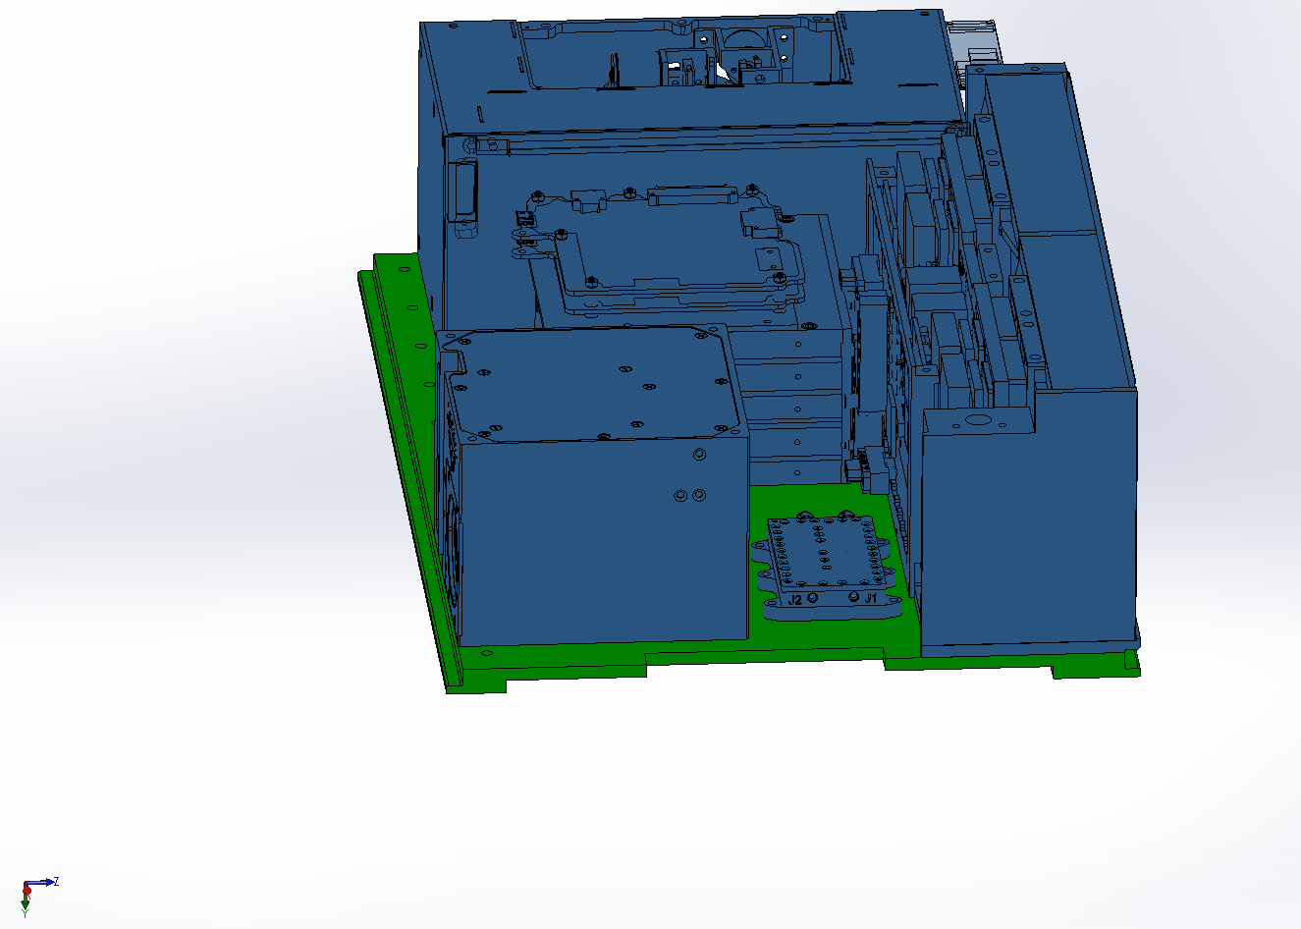
Structure Overview
Primary load bearing component (green)
Rails designed per PSC 2002367C.
Main mounting surface for major components (blue)
Launch vehicle deployer interface

Slide 6
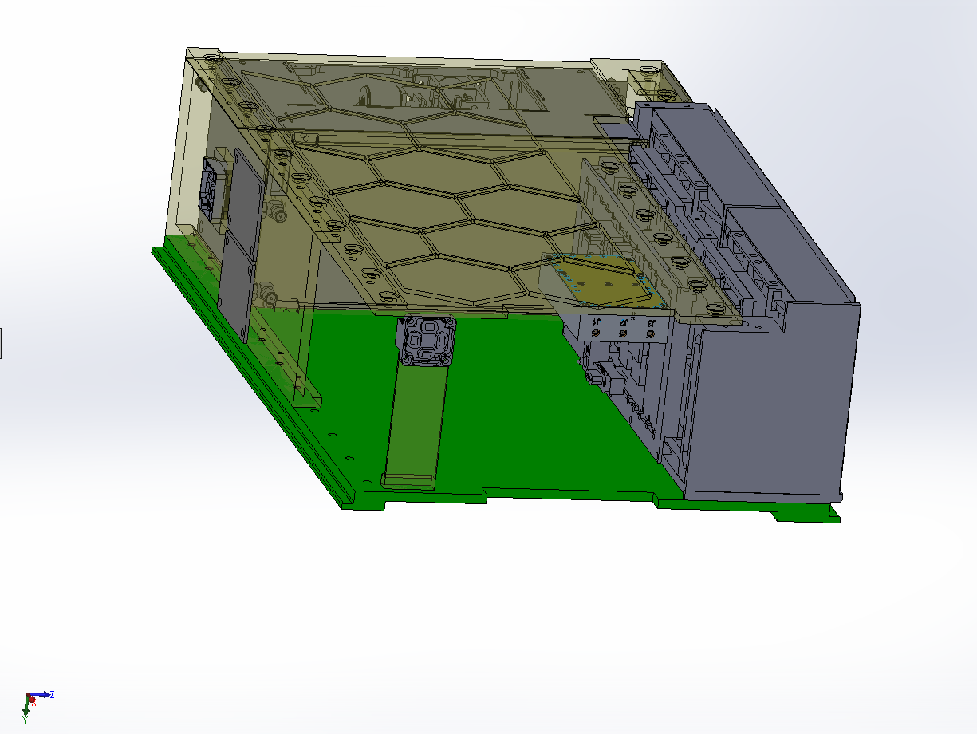
Structure Overview Pt.2
Secondary structures (yellow) provide mounting solutions for smaller components
BIT-3 and Mini-NS provide additional structure support
Lightweighting to reduce mass

Slide 7
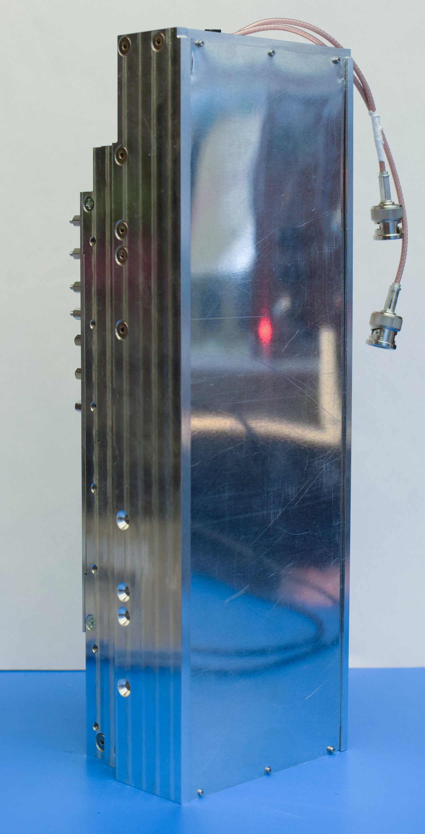
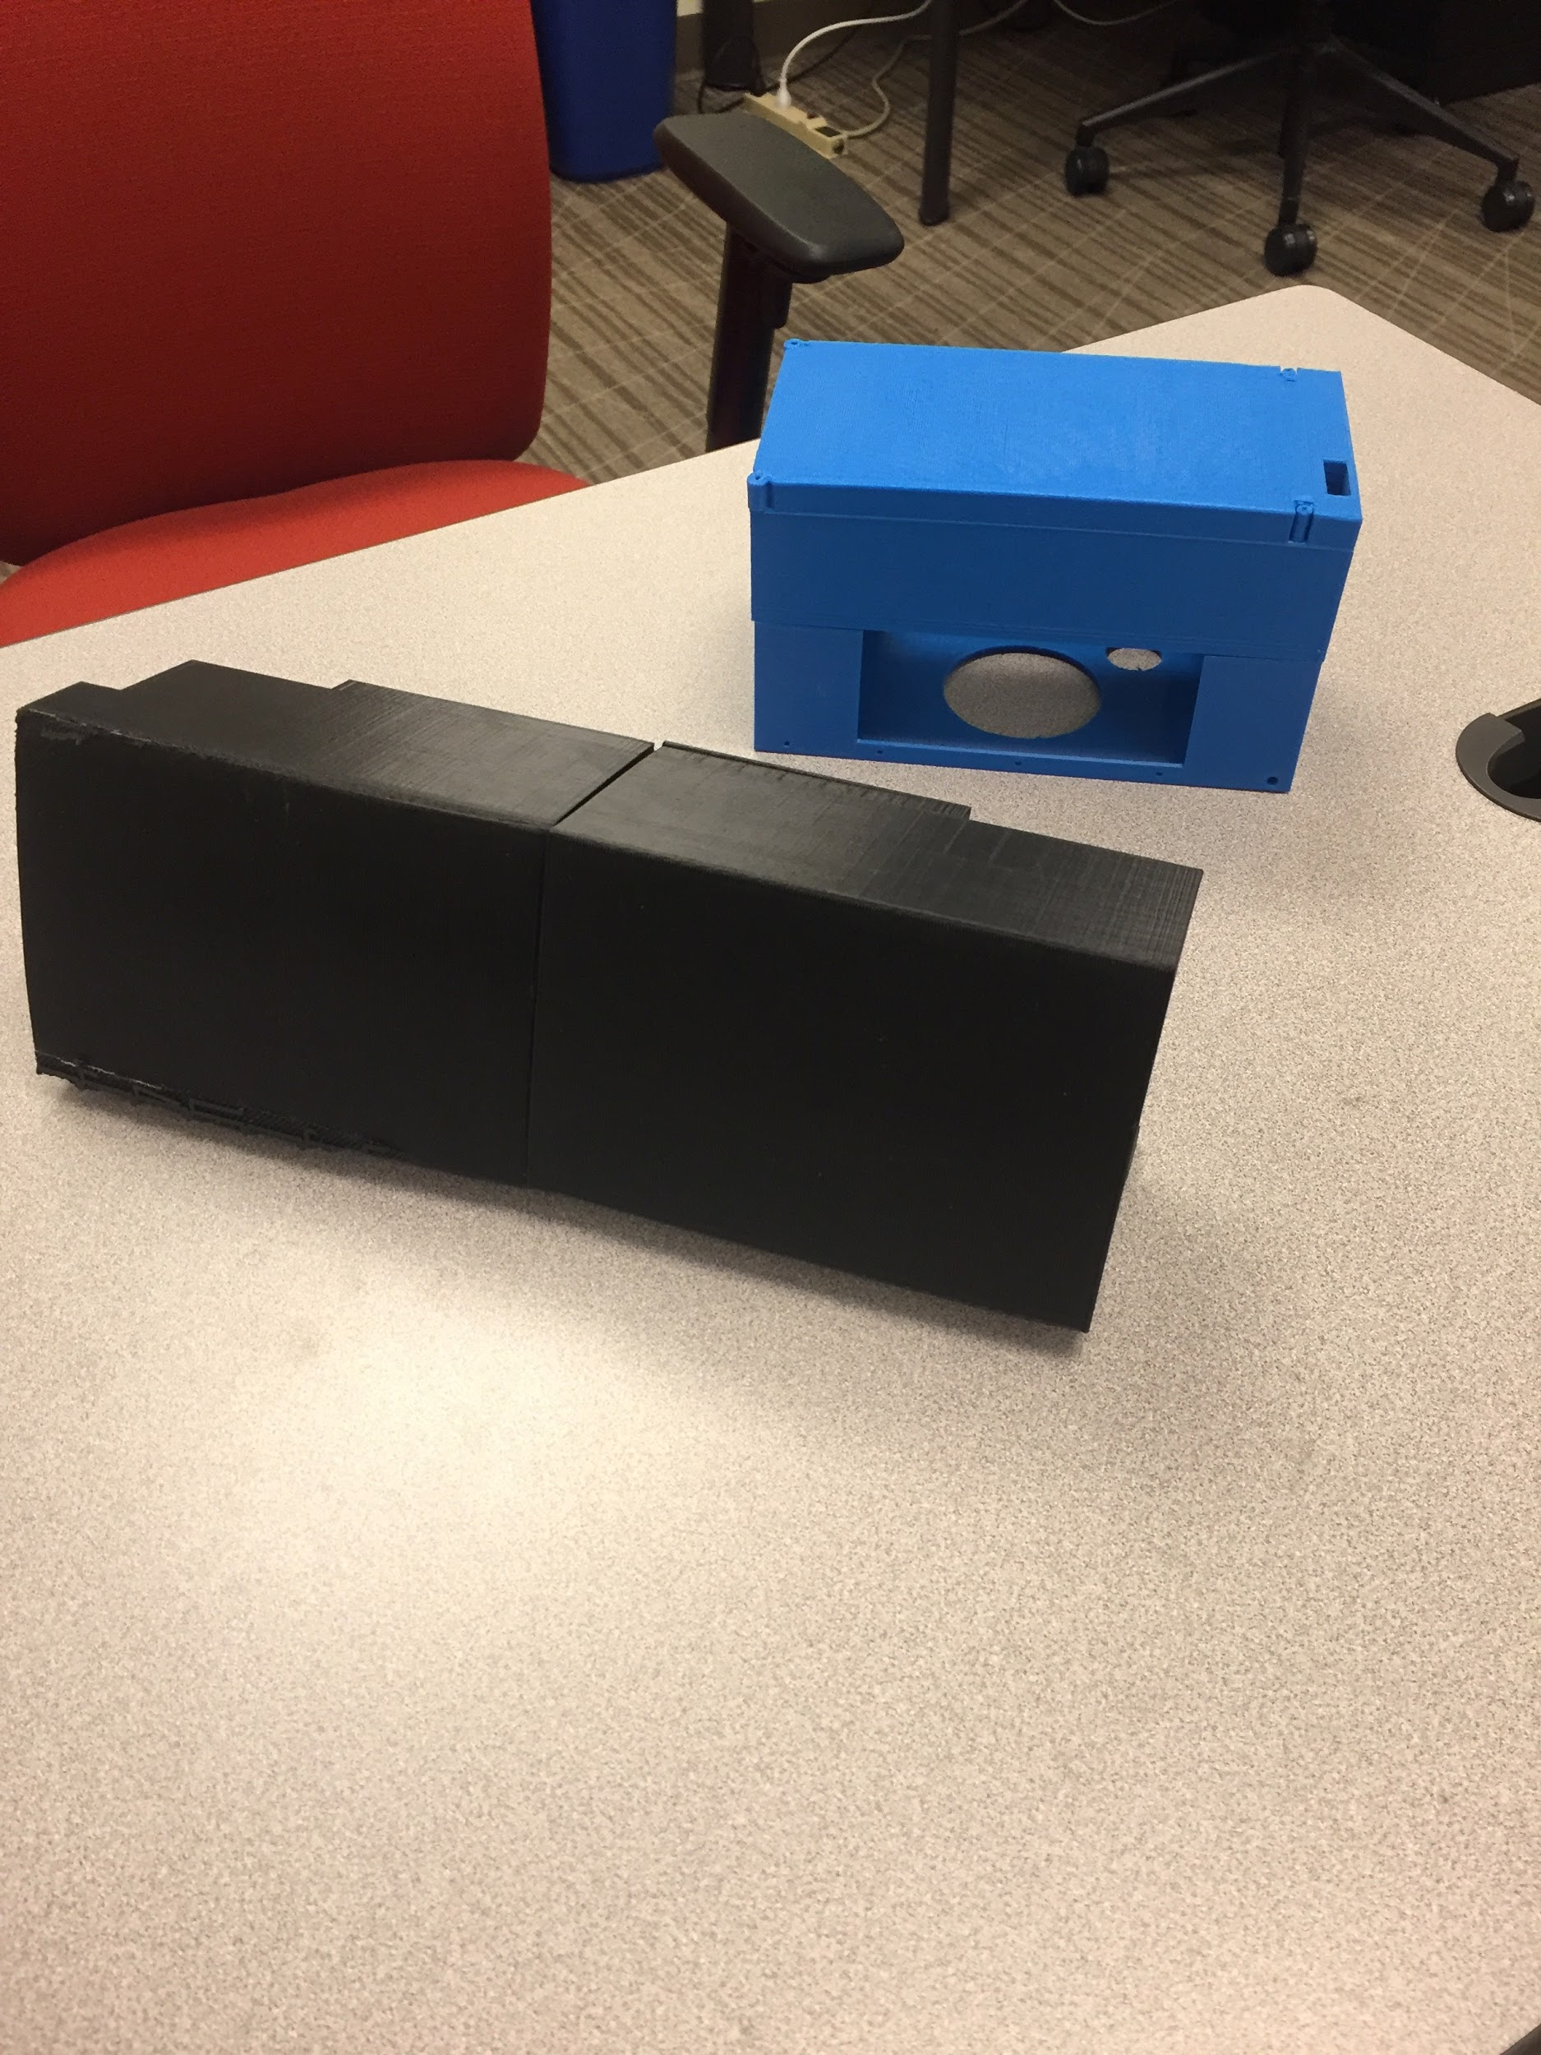
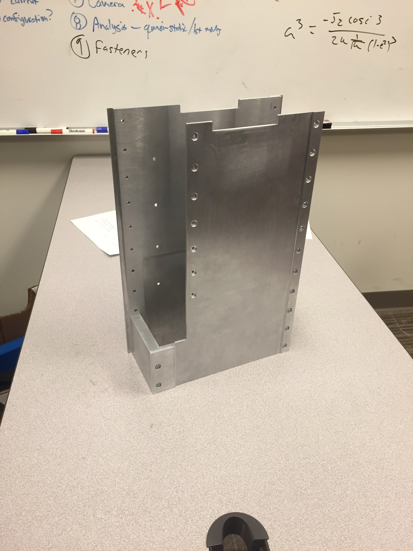
Integration Model and Test Model
Payload EDU
3D printed components
Machined structure model

Slide 8
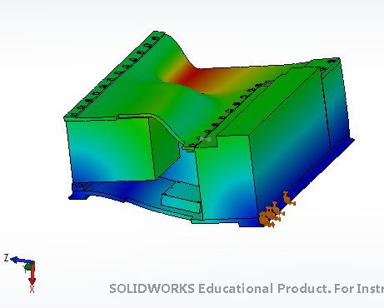
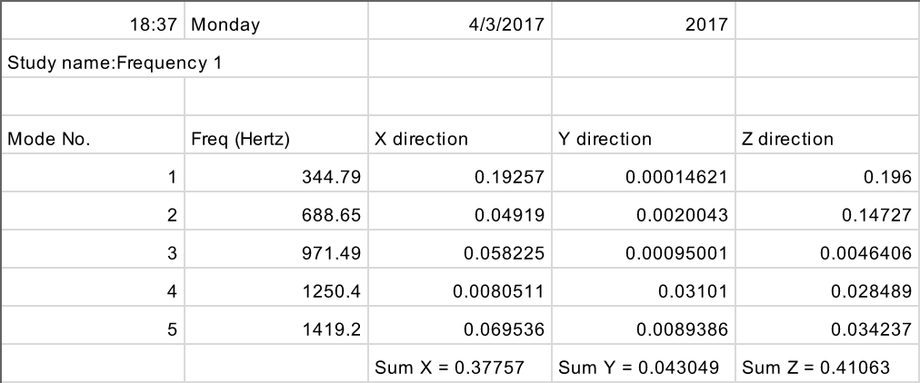
Modal Analysis
Modal analysis requested by deployer.

Slide 9
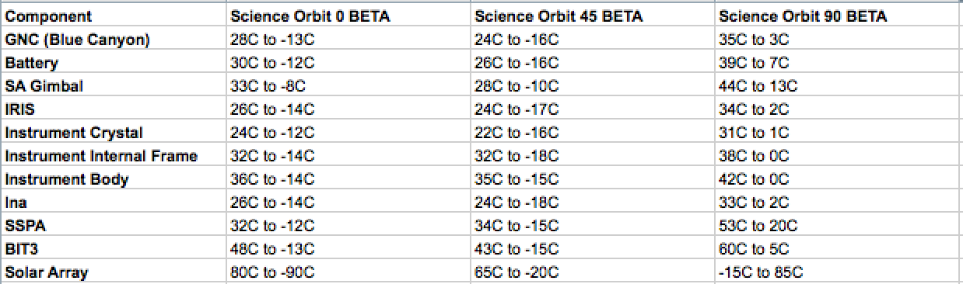
Thermal Analysis

Slide 10
Future Work
Quasi-static analysis to simulate vibrational loads at launch.
Finalize design for CDR.
Investigate battery thermal zone.
Physical tests on flight hardware.

Slide 11
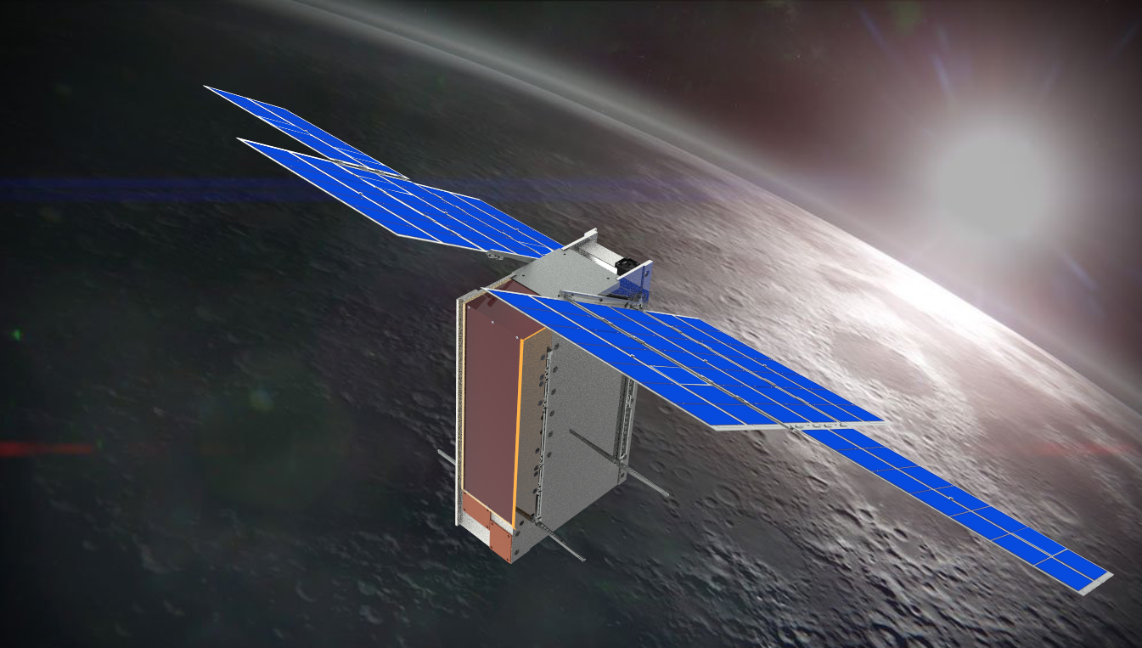

Acknowledgements
ASU Space Grant
Dr. Craig Hardgrove (LunaH-Map PI)
Igor Lazbin (AZ Space Tech)
Valentin Ivanitski (AZ Space Tech)

Slide 12
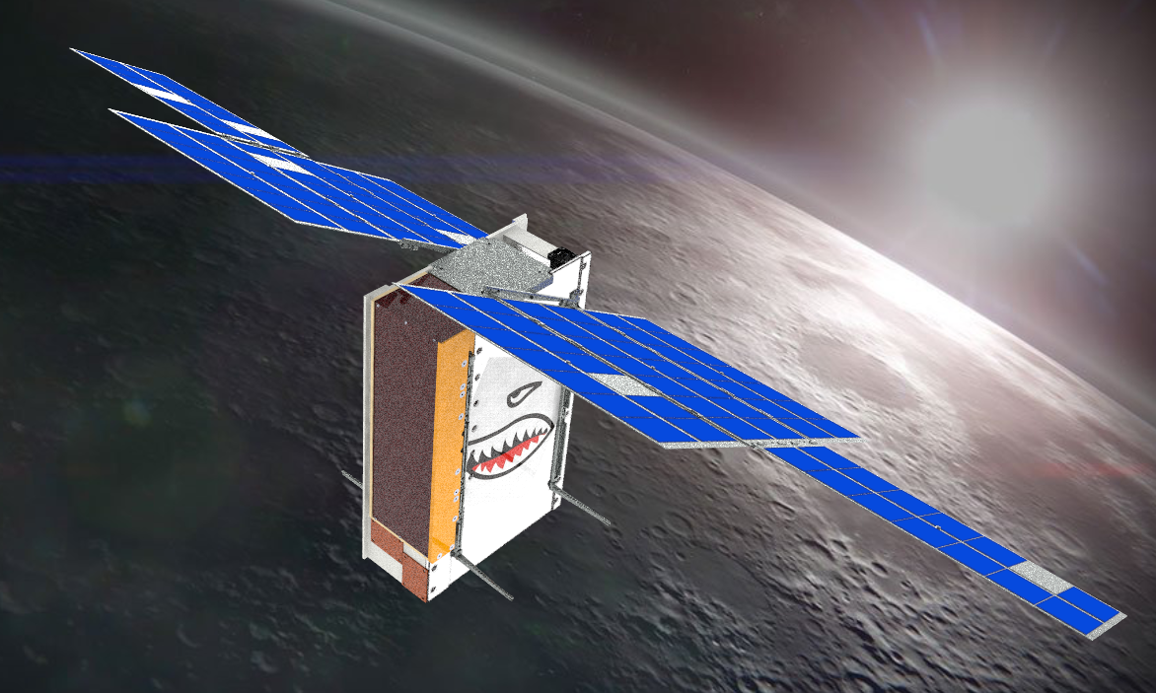
Questions?

